Slide 1
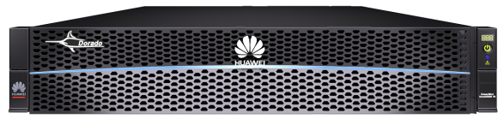




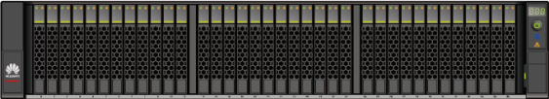
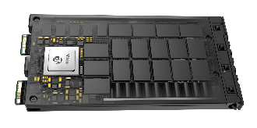
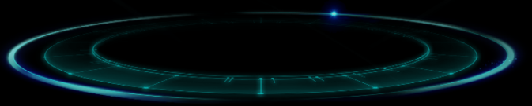
Super Performance with Innovative FlashLink® Algorithms
Overview | Trend and Product Strategy | Proposed Storage Products | Storage Platform | High System and Data Availability | High Performance | Unified Management | Comprehensive Security | Open Ecosystem
Controller with 5 chips
Reconstruction
0101010101
Core
53.13%
81.79%
0101010101
010101010101011
Many-core scheduling
010101010101011
010101010101011
Core
Core
010101010101011
010101010101011
300 min/TB
15 min/TB
Ordered by reboot sequence
1
2
3
4
5
010101010101011
010101010101011
Core
Smart SSD enclosure
Many-core algorithm
2x computing power
Service grouping
20x reconstruction speed
AI chip + Cache algorithm
50% cache hit ratio
01011
Metadata
Data read
SSD
New data
Data write
Garbage collection data
Advanced feature
Reconstruction
Garbage collection
Full-stripe writes
Less write amplification
Multi-streaming data separation
Less garbage collection
Global I/O priority adjustment
Lower latency
Notes:
What's so innovative about the algorithms on OceanStor Dorado V6? FlashLink algorithms implement collaboration of controllers, SSD enclosures, and SSDs in the following ways:
First, Kunpeng processors work with the many-core algorithm to more than double the computing power.
Second, Kunpeng processors in smart SSD enclosures cooperate with the service grouping technology to offload reconstruction services. This speeds reconstruction by 20 times as compared with HDDs.
Third, AI chips partner with the intelligent cache algorithm so that the system can prefetch cache resources to process a large number of repeated I/O models. This improves the cache hit ratio by 50%.
Fourth, full-stripe writes reduce write amplification.
Fifth, multi-streaming technology reduces garbage collection by separating metadata and other data.
Sixth, I/Os are assigned different priorities for resources to deliver stable and low latency.

Slide 2




Adaptive Deduplication and Compression Ensure
Overview | Trend and Product Strategy | Proposed Storage Products | Storage Platform | High System and Data Availability | High Performance | Unified Management | Comprehensive Security | Open Ecosystem
Adaptive Inline/Post-deduplication/Compression
Highest Performance with Deduplication
load %
IOPS
95%
Deduplication Disabled
Adaptive
Huawei
15%
Deduplication Enabled
Inline-dedup
Post-dedup
Time
Deduplication Disabled
Other Vendors
28%
Inline-dedup
Post-dedup
Deduplication Enabled
SSD/HDD
SSD/HDD
SSD/HDD

Slide 3
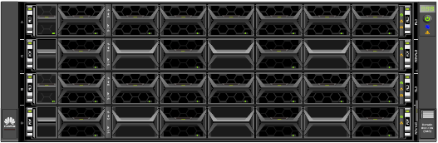

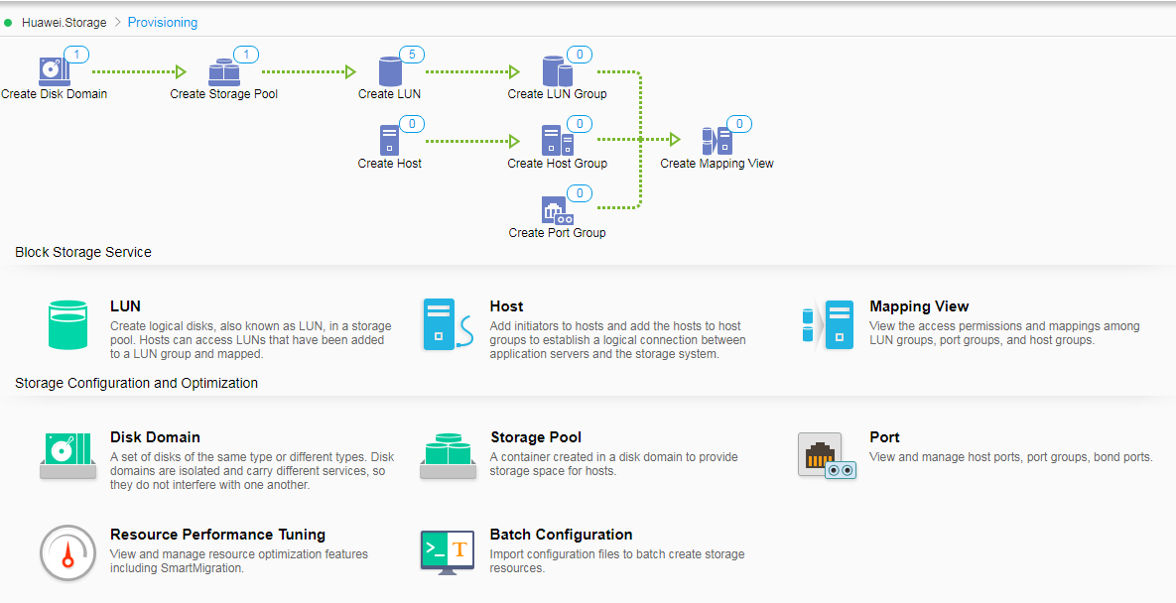
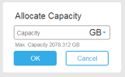
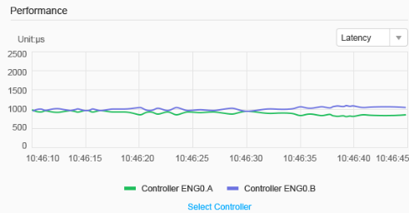
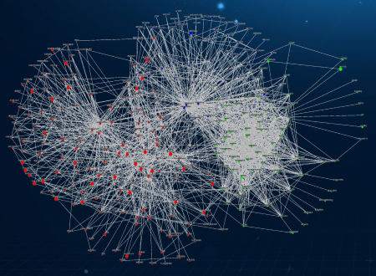
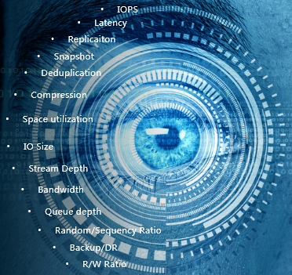
Device-Cloud Full Stack Management
Overview | Trend and Product Strategy | Proposed Storage Products | Storage Platform | High System and Data Availability | High Performance | Unified Management | Comprehensive Security | Open Ecosystem
Storage
Database
VM
VDI
OceanStor Dorado V6
DeviceManager
SmartConfig
DME
eService
Web-based GUIs
Step-by-step guide for FCAPS management
3-step host configuration
Add a storage device.
Set the IP address.
Set the capacity.
Unified storage management
Topology and data path analytics
Long-term log and performance storage and analytics
Cloud-based remote AI services
24/7 monitoring
5-min service ticket creation
All-round health check
Regular performance analytics
Notes:
Maintainability is an important factor for our storage platforms. OceanStor Dorado V6 provides a complete set of intelligent management systems covering storage, hosts, data centers, and clouds:
For storage, DeviceManager delivers simplified, easy-to-use graphical storage management environment
For hosts, we have SmartConfig that allows the user to configure the host configuration in three steps
For data centers, OceanStor DJ can unify the management of all storage devices
For cloud, eService provides cloud-based AI maintenance for all operations

Slide 4
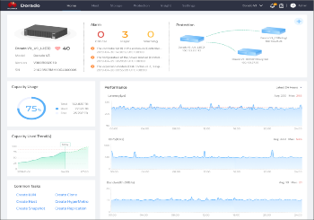
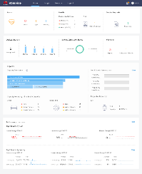
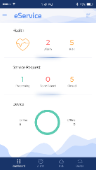
DeviceManager & eService Management Software
Overview | Trend and Product Strategy | Proposed Storage Products | Storage Platform | High System and Data Availability | High Performance | Unified Management | Comprehensive Security | Open Ecosystem
eService
DeviceManager
eService app
DeviceManager: built-in management software
eService: cloud intelligent management service
Simplified management to facilitate service provisioning, protection, and configuration
Object topology visualization
Comprehensive performance monitoring and analytics
Remote cloud management
Cloud-based big data intelligent system covering storage management services such as fault prediction, capacity management, and performance exception analytics
Proactive O&M services with customer system risk prediction and extensive Huawei support teams
Notes:
Next, let's talk about our DeviceManager. As I mentioned earlier, it is a GUI-based management software that runs on a user-friendly and easy to operate interface. This was a conscious decision to change from the perspective of engineers to that of common IT personnel. This helps simplify operation and maintenance and improve efficiency. Now, you don't need to be an expert to manage your system.
Our cloud-based eService supports cloud analysis for big data, intelligent analysis and prediction for edge storage devices, and system interconnection with our own service teams.

Slide 5
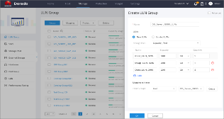
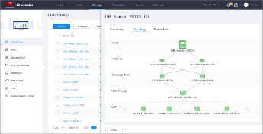
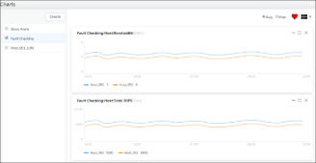
DeviceManager Highlights
Overview | Trend and Product Strategy | Proposed Storage Products | Storage Platform | High System and Data Availability | High Performance | Unified Management | Comprehensive Security | Open Ecosystem
Simplified configuration
Visualized object maps
Powerful analytics
Configuration-free storage pool
Automatic host discovery
One-step configuration
Single port configuration
Topologies of service objects
Topologies of protected objects
Performance view template
Simultaneous historical and real-time performance display
Performance correlation analytics
One-step mapping
Topologies of LUN group
Performance correlation analytics
Notes:
Now, let's look at the highlights of DeviceManager. Originally, its management interface was customized for engineers. But now, it has been redesigned with an easy-to-use interface for IT personnel to simplify and streamline operation and management.
Firstly, storage pools no longer require individual configuration. The host is discovered automatically for one-step service configuration and easier development and deployment of nodes.
Secondly, DeviceManager displays the topologies of service objects and protected objects intuitively with object maps, making it easier to query your info.
Thirdly, DeviceManager uses real-time data collection of performance and correlation analytics. As a result, it can preset performance views, display historical and real-time performance data, and identify correlations.

Slide 6


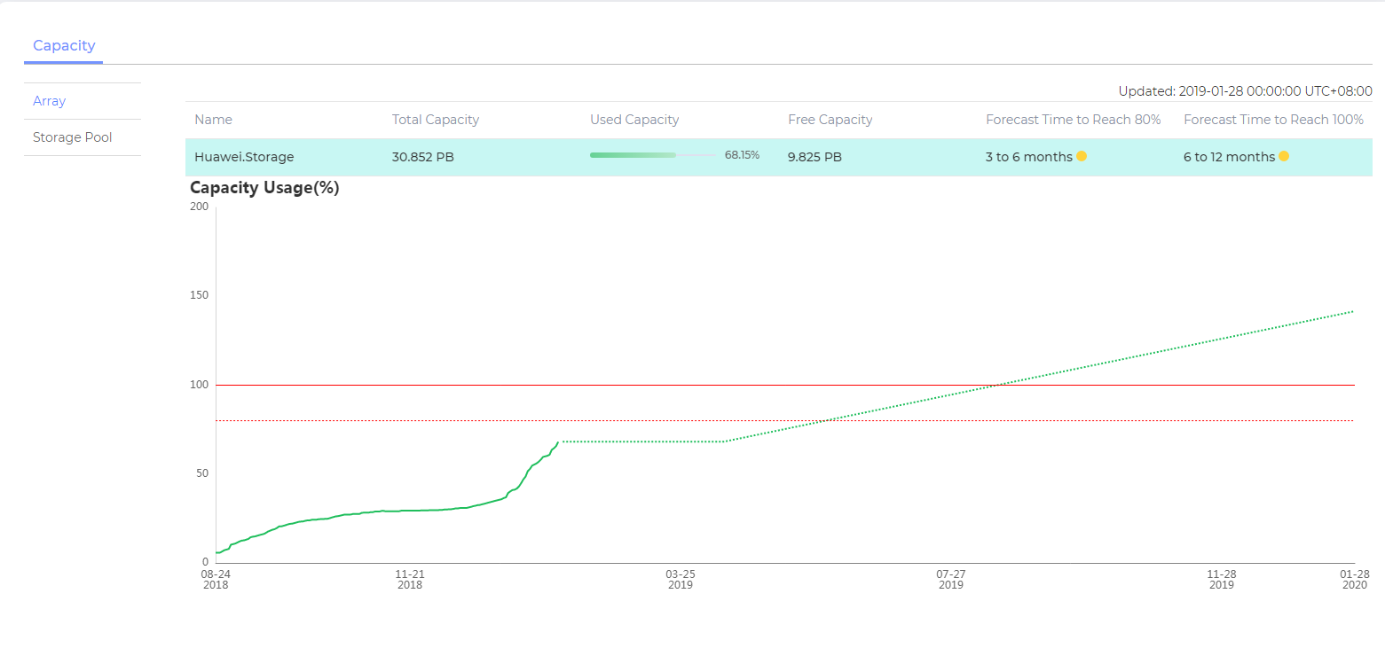
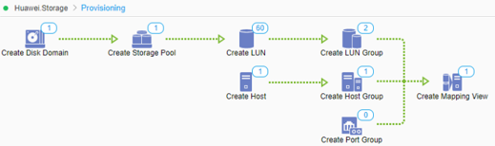
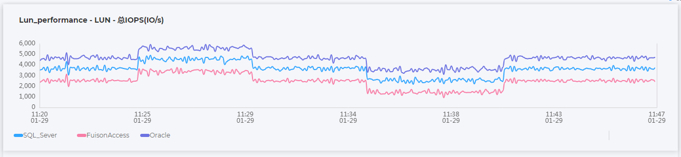
Streamlined, AI-Powered Device Management
Overview | Trend and Product Strategy | Proposed Storage Products | Storage Platform | High System and Data Availability | High Performance | Unified Management | Comprehensive Security | Open Ecosystem
1
7 steps
One-click service provisioning for faster O&M and lower OPEX
2
Intelligent capacity prediction (365 days) and on-demand capacity expansion for more precise IT investment
Create LUN Group
Advanced
*
Name
SQL
3
Collection of real-time performance data for intelligent decision-making on the cloud
Now
New LUN
Existing LUN
*
Storage Pool
Storage Pool_001
*
Application Type
Default
LUNs:
*
Name Prefix
*
Capacity per LUN
*
Quantity
LUN001
500
GB
10
Map To
Host group
Please Select
Create
OK
Cancel
Notes:
Now, let's discuss for a moment how Device Manager simplifies the usage of a single device.
The first section demonstrates our intelligent and efficient management via DeviceManager. Older equipment required seven steps to create LUNs. Now, we can provision services in just one click to streamline O&M. The second section shows intelligent capacity predictions 365 days in advance so that users can calculate capacity purchases for expansion on demand. User IT investment is optimized.
The third section demonstrates real-time collection of performance data. The intelligent decision-making of our DeviceManager guarantees stability for all system applications. Multiple services run smoothly at the same time during peak hours, device capabilities are fully utilized, and the IT investment is optimized.

Slide 7




OceanStor DME — Automatic Full-Lifecycle Management
Overview | Trend and Product Strategy | Proposed Storage Products | Storage Platform | High System and Data Availability | High Performance | Unified Management | Comprehensive Security | Open Ecosystem
Model training
Remote O&M
Bare metal
VM
Container
HUAWEI CLOUD
3rd-party private cloud
Model pushdown
eService
RESTful API
OceanStor DME
Intelligent risk prediction
Intelligent fault analytics
Generation
Usage
Protection
Archiving
Flow
Rest/CLI/Cinder
Converged
One GUI, message, and model
Automatic
Provisioning and O&M
SAN
NAS
Object
Intelligent
Prediction, analysis, and optimization
Notes:
Let's take a moment to look at OceanStor DJ in more detail.
First, it is unified. It provides unified APIs and management portals.
Second, it is flexible. It also has a variety of custom APIs.
Next, it is intelligent. OceanStor DJ supports intelligent resource provisioning. It also identifies and analyzes service workload models. As a result, we were able to do away with the traditional seven-step configuration and replace it with one-click resource application and automatic provisioning for a five-fold increase in efficiency.
As for the intelligence, first, we have intelligent data flow between different service levels. This allows for seamless data migration, online capacity expansion of resource pools, and seamless replacement of legacy storage and system upgrades.
Then we have intelligent fault analysis. OceanStor DJ implements end-to-end visual fault location and root cause analysis. It also uses a diagnosis library for intelligent fault location and one-click automatic recovery to shorten fault recovery.
Our final feature is intelligent risk prediction. Our OceanStor DJ analyzes the performance, capacity, and service level fulfillment of storage resource pools so that the systems may easily manage multiple resource pools.

Slide 8
Four Level Security Ensures System and Data Security
Overview | Trend and Product Strategy | Proposed Storage Products | Storage Platform | High System and Data Availability | High Performance | Unified Management | Comprehensive Security | Open Ecosystem
Storage Service Security
Management Security
ITU-T X.805 telecom network security architecture based model
Management Security
Role-based access control
Storage Service Security
data at rest encryption
DoD standard data destruction
Storage Network Security
Secure transmission protocols (SSH, SFTP, HTTPS, and SNMPv3)
Storage System Security
The RSA 2048/4096 algorithm is used, which has the top security level in the industry
Resource access control
resource access authentication and authorization
Data encryption
Data destruction
Role-based access control
User security policies
Password security
Authentication and authorization
Log and alarm management
Storage Network Security
Network isolation
Transmission security
Storage System Security
Storage OS security hardening
Security patches
Web security
Secure boot and software integrity protection

Slide 9
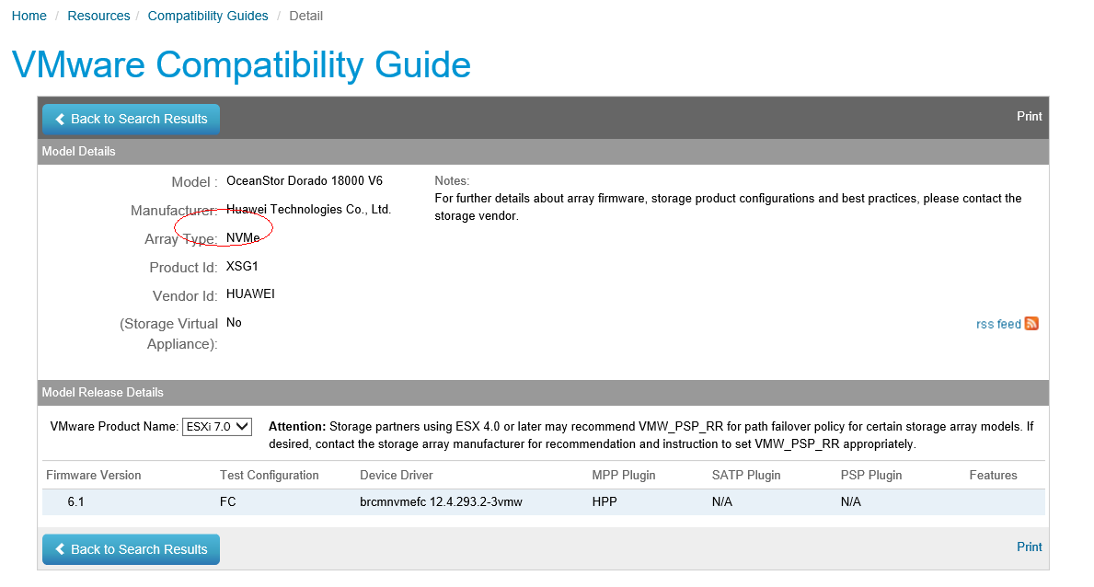
Integrated with 3rd party platforms such as VMware，Brocade , Veeam
Overview | Trend and Product Strategy | Proposed Storage Products | Storage Platform | High System and Data Availability | High Performance | Unified Management | Comprehensive Security | Open Ecosystem
Huawei storage compatibility
Huawei is first storage vendor that has passed VMware NOF-FC&RDMA RoCE dual-protocol certification https://www.vmware.com/resources/compatibility/detail.php?deviceCategory=san&productid=50682&releases_filter=448&deviceCategory=san&details=1&partner=242&arrayTypes=8&isSVA=0&page=1&display_interval=100&sortColumn=Partner&sortOrder=Asc
APP
Database
Oracle/DB2/SQL Server
Big Data
CDH, MapR, Hortonworks
Volume
Mgt.
Veritas StorageFoundation
File system
FAT, ZFS, NIFS
OS
OS
Windows/Linux/Oracle
Cloud OS
OpenStack/FusionCloud
VMware
Server
AIX/HP UNX/Solaris
X86
backup
NBU/CV/Veeam
Switch
Brocade, Cisco, Mellanox
3rd-party
Storage
SVC/VPlex
Network
Mnmg.
NetApp OCI/BMC/CA
Huawei Storage

Slide 10

VMware Integration
Overview | Trend and Product Strategy | Proposed Storage Products | Storage Platform | High System and Data Availability | High Performance | Unified Management | Comprehensive Security | Open Ecosystem
Virtualization Platform & Cloud Management
vCenterPlugin and VASA (Vvol) integration: provides vCenter-based integration management, enhances VVol-based QoS and storage profile capabilities, and supports VASA resource management in multiple data centers.
VMware vCloud Director
VMware vRealize
Operations
VMware vCenter Server
vROps (monitoring)
vCenter plugin (storage integration management)
VASA (VVol feature)
Integrates with vROps to provide O&M capabilities based on storage service performance, capacity, alarms, and topologies, implementing unified O&M management.
VMware vRealize
Orchestrator
vRO/vRA (workflow)
REST
REST
Enhances vRO & vRA integration and supports replication, active-active, snapshot, and consistency group capabilities based on OceanStor.
VMware vCenter
Site Recovery Manager
SRM (DR)
OceanStor
Interconnects with SRM to support replication, active-active failover, failback, and test drills and provides end-to-end solutions.
REST

Slide 11
OpenStack Integration
Overview | Trend and Product Strategy | Proposed Storage Products | Storage Platform | High System and Data Availability | High Performance | Unified Management | Comprehensive Security | Open Ecosystem
OceanStor Cinder Driver architecture:
OpenStack
OpenStack Pike release Cinder Driver API
Cinder API
Feature Details | OpenStack P release
Diver | Volume driver API | OceanStor
Volume management | create_volume | Yes
 | delete_volume | Yes
 | create_clone_volume | Yes
 | extend_volume | Yes
Snapshot management | create_snapshot | Yes
 | delete_snapshot | Yes
 | create_volume_from_snapshot | Yes
Storage monitoring | get_volume_stats | Yes
Host interconnection | copy_image_to_volume | Yes
 | copy_volume_to_image | Yes
 | attach_volume | Yes
 | detach_volume | Yes
Others | initialize_connection | Yes
 | terminate_connection | Yes
OpenStack package
(OpenStack)
Cinder Scheduler
Cinder Volume
eSDK
REST API
OpenStack plugin
(Huawei-developed)
OceanStor
Applicable version:
Community Edition | Red Hat
OpenStack Mitaka OpenStack Newton OpenStack Pike OpenStack Queens OpenStack Rocky OpenStack Stein | Red Hat OpenStack Platform 10.0

Slide 12
CSI plug-in for Container Integration
Overview | Trend and Product Strategy | Proposed Storage Products | Storage Platform | High System and Data Availability | High Performance | Unified Management | Comprehensive Security | Open Ecosystem
Kubernetes Master
Applicable version:
Kubernetes 1.13/1.14/1.15
Driver-registrar
Process for Kubernetes to use the OceanStor CSI plug-in to provide volumes:
The Kubernetes Master instructs the CSI plug-in to create a volume. The CSI plug-in invokes an OceanStor interface to create a volume.
The Kubernetes Master instructs the CSI plug-in to map the volume to the specified node. The CSI plug-in invokes the OceanStor interface to map the volume to the specified node host.
The target Kubernetes node to which the volume is mapped instructs the CSI plug-in to mount the volume. The CSI plug-in formats the volume and mounts the volume to the specified directory of the Kubernetes.
1
CSI plug-in
2
External-provisioner
Kubernetes Node
OceanStor
Driver-registrar
Container
SCSI/iSCSI
/mnt
External-attacher
CSI plug-in
Block dev
3
CSI plug-in assistance service provided by the Kubernetes community
Kubernetes Node
CSI plug-in
Deployed on all Kubernetes nodes based on the CSI specifications to complete volume creation/deletion, mapping/unmapping, and mounting/unmounting.
Driver-registrar
External-attacher
CSI plug-in
Management plane
Data plane

Slide 13
Overview | Trend and Product Strategy | Proposed Storage Products | Storage Platform | High System and Data Availability | High Performance | Unified Management | Comprehensive Security | Open Ecosystem
Company Overview
Project Scope and Huawei Understanding
Huawei Technical Solution
Huawei Infrastructure Overview
Server
Storage
HCI&CI
Huawei Infrastructure Service
Notes:
标题
改为Project Scope and Huawei Understanding
Huawei Solution改为What Huawei could do

Slide 14
标书关注的技术领域
内容组织参考：
整体技术要求和SOC 满足度
标书配置要求和华为方案
华为HCI&CI全景图及适配的场景
架构- 可靠性，冗余设计等
工程能力 – 预集成，扩容规格，线性扩容等
硬件设计 – 计算
硬件设计 – 存储
硬件设计 – 网络
虚拟化，操作系统，上层应用等
安全设计
管理
安全
容灾备份归档方案-
长远Roadmap（Optional）
High Availability Design（高可靠）
Engineering, Deployment & Systems Portfolio（工程能力）
Compute, Servers & Cabinets （硬件-计算）
Storage （硬件-存储）
Backup （容灾、备份）
Networks（硬件-存储）
Virtualization, Automation & Cloud Orchestration （云化/虚拟化）
Security （安全）
Support & Management （管理）
Maintenance Upgrades （升级）
DR & Business continuity（容灾、备份）

Slide 15
Company Overview
Project Scope and Huawei Understanding
Huawei Technical Solution
Huawei Infrastructure Service
Notes:
标题
改为Project Scope and Huawei Understanding
Huawei Solution改为What Huawei could do

Slide 16
Service Requirement Understanding
Huawei Infra Service Portfolio
Service Scope and SLA(培训服务的online and off line 说清楚和优势)
Huawei Local Service Capability(Resource, Tools, Process , spare center)
Service Partner Ecosystem
Achieve Success during epidemic(呈现一下疫情期间的表现)
注：针对运营商的业务模块，展开来讲对不同系统的交付和服务经验，展现对不同应用服务的经验，展示的运营商业务系统框架

Slide 17
Thank you

Slide 18

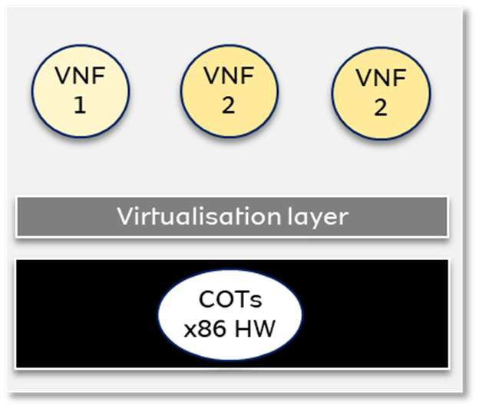
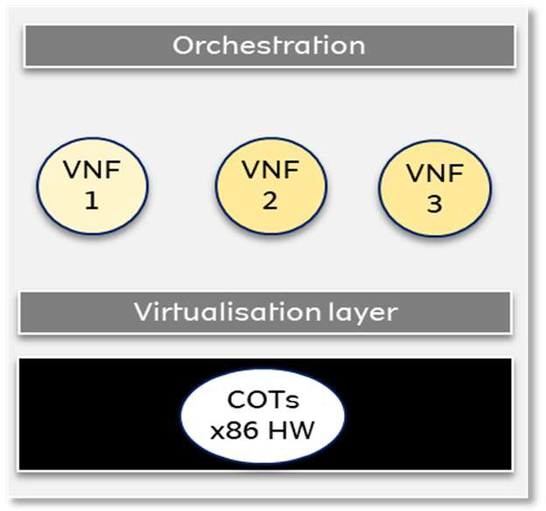
MTN Strategy Understanding
MUNIC
SERVICE AGILITY
INNOVATION
& DIFFERENTIATION
CAPITAL EFFICIENCY
OPERATIONAL EFFICIENCY
MUNIC 1.0
Virtualisation
MUNIC 2.0
Orchestration & Automation
MUNIC 3.0
Cloud Native
Centralized cross domain Orchestration
Container 1
VNF 1
Container 2
VNF 2
Container 3
VNF 3
Dev Ops Operating System
COTs x86 HW
Decoupling HW & SW
Data Centre Modernization
Deployment of common HW, VNFs, PSI, Abstraction Layer
Inventory & Orchestrator
SDN Controller (SD-WAN, SDN-DC)
Expansive VNF automated deployment
Cloud scale deployment of VNFs across many VMs and data centres
Centralised policy based automation
Self healing and low touch network
Key Requirement for Infrastructure
Standardize to support both IT and CT business
Future-oriented to support Telco 5G and Digital Business
Open and flexible to support MTN Cloud Transformation
High reliability and scalability to support explosive data growth

